Slide 1

Andrew Stephan
ACCT 3220 – Acctg Mechanics REVIEW DAY!!!
Mechanics & Adjusting Entries – In-Class

Slide 2

Key Points from the Video
Journal entries can include balance sheet & income statement accounts (or Dividends)
Debits increase assets and expenses (& Div)
Credits increase liabilities, equity, and revenue
Debits = Credits
Assets = Liabilities + Equity
Net income flows into Retained Earnings (Equity)
This affects almost everything we learn this semester.

Slide 3
Account Types & Financial Statements
Balance Sheet
Assets
Liabilities
+
Equity
=
C/S
Retained Earnings
Statement
of
Stockholders’
Equity
Revenue
Income
Statement
Expense
Net Income
Dividend

Slide 4
Go to handout…
Complete journal entries 1 – 10 (Not 11). These events occurred DURING the period.
Things to consider:
What accounts are involved? Up or Down? Do we balance?
How financial statements are affected?
Will anything cause this account to move later (time/use)?

Slide 5
Adjusting Entries

Slide 6
Accrual Accounting
Definitions
Deferred: Cash is exchanged, but revenue or expense is not recognized until later.
Accrued: No cash is exchanged, but revenue or expense is recognized now.
Notes:
First talk about “cash in the past”
Cash received in advance (unearned revenue or cash advance) – cash up front for 12 month subscription:
-have you earned it?
-have you received more cash that needs to be recorded?
Cash paid in past (prepaid or fixed asset):
-record new consumption (new depreciation or reduction of prepaid insurance/warranty/etc)
-any new cash paid that needs to be recorded?
Second talk about “cash in the future”
2) Services/goods in advance (collectible):
-do you need to record any new services/goods provided?
-have you collected on any old receivables?
Services/goods received in advance (payable):
-any new services/goods received to record?
-any old payables that have been paid?

Slide 7
Accrual Accounting
 | Deferred (receive/pay cash early) | Accrued (receive/pay cash late)
Revenue (earned) | 1) Deferred revenue (receive a down payment, but have not yet delivered goods, so no revenue) | 3) Accrued revenue (delivered goods to customer, but have not yet been paid)
Expense (incurred) | 2) Deferred (or prepaid) expense (pay rent in advance, but do not have access to building yet) | 4) Accrued expense (used electricity for a month, but haven’t paid yet)
Notes:
First talk about “cash in the past”
Cash received in advance (unearned revenue or cash advance) – cash up front for 12 month subscription:
-have you earned it?
-have you received more cash that needs to be recorded?
Cash paid in past (prepaid or fixed asset):
-record new consumption (new depreciation or reduction of prepaid insurance/warranty/etc)
-any new cash paid that needs to be recorded?
Second talk about “cash in the future”
2) Services/goods in advance (collectible):
-do you need to record any new services/goods provided?
-have you collected on any old receivables?
Services/goods received in advance (payable):
-any new services/goods received to record?
-any old payables that have been paid?

Slide 8
Adjusting Entries
All cash transactions have already been recorded.
Adjusting Entry:
An adjusting entry is made at the end of an accounting period to record noncash economic events that occurred during that period.
Ask yourself:
Have I earned any revenue or incurred any expenses that have not yet been recorded?
Notes:
Big question: Has anything changed between now and the period end?
Note some examples:
3) Advances/unearned revenue (cash advance so owe goods/services)
4) prepaids (insurance, magazine subscriptions)

Slide 9
Go to handout…
Complete entry 11 and remaining Adjusting Entries

Slide 10
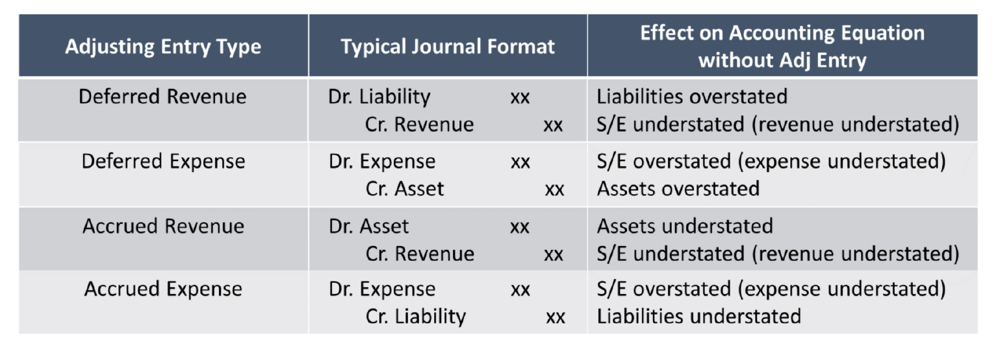
Summary of Adjusting Entries

Slide 11
Closing Thoughts
Know journal entries inside and out.
Always use a journal entry when cash moves, but consider also if you earn revenue or incur expenses without cash moving.
When understanding effects of errors, write out correct entry and see what changes.
If today was confusing, get help now!

Slide 12
Andrew Stephan
ACCT 3220
Mechanics & Adjusting Entries – In-Class

